Slide 1
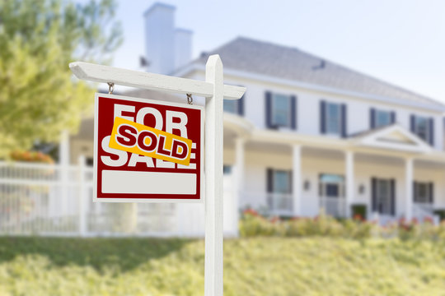
Real Estate Sales in Perth 2010 to 2020
Analysis completed by
Athira Reji, Zonia Quiroga & Aaron Bilbow

Slide 2
1.Does the cost of homes in Perth depend on its proximity to the central business district? 2. Does house characteristics including floor area, number of bedrooms, number of bathrooms, proximity to schooling or transport infrastructure/development have any influence on the housing prices? 3. Are house costs and the quality of the neighbourhood schools correlated? Examine if homes that are close to schools tend to sell for more money. 4. Does the cost of homes in Perth depend on its closeness to public transit (such as railway stations and bus stops)? Investigate if houses close to points of public transportation tend to be more expensive than those further away

Slide 3
The project aims to analyse the housing price trends in Perth, Australia. Identify areas of high and low property values. Identify key factors in the suburb sale price growth. Understand whether factors including location, floor area, number of bedrooms, number of bathrooms, proximity to schooling or transport infrastructure/development and other amenities have any influence on the housing prices. The research will reveal the relative significance of different attributes and their combined impact on property values
All data being used is from the CSV data generated from:
Kaggle
We have only used data from 2010 to 2020

Slide 4
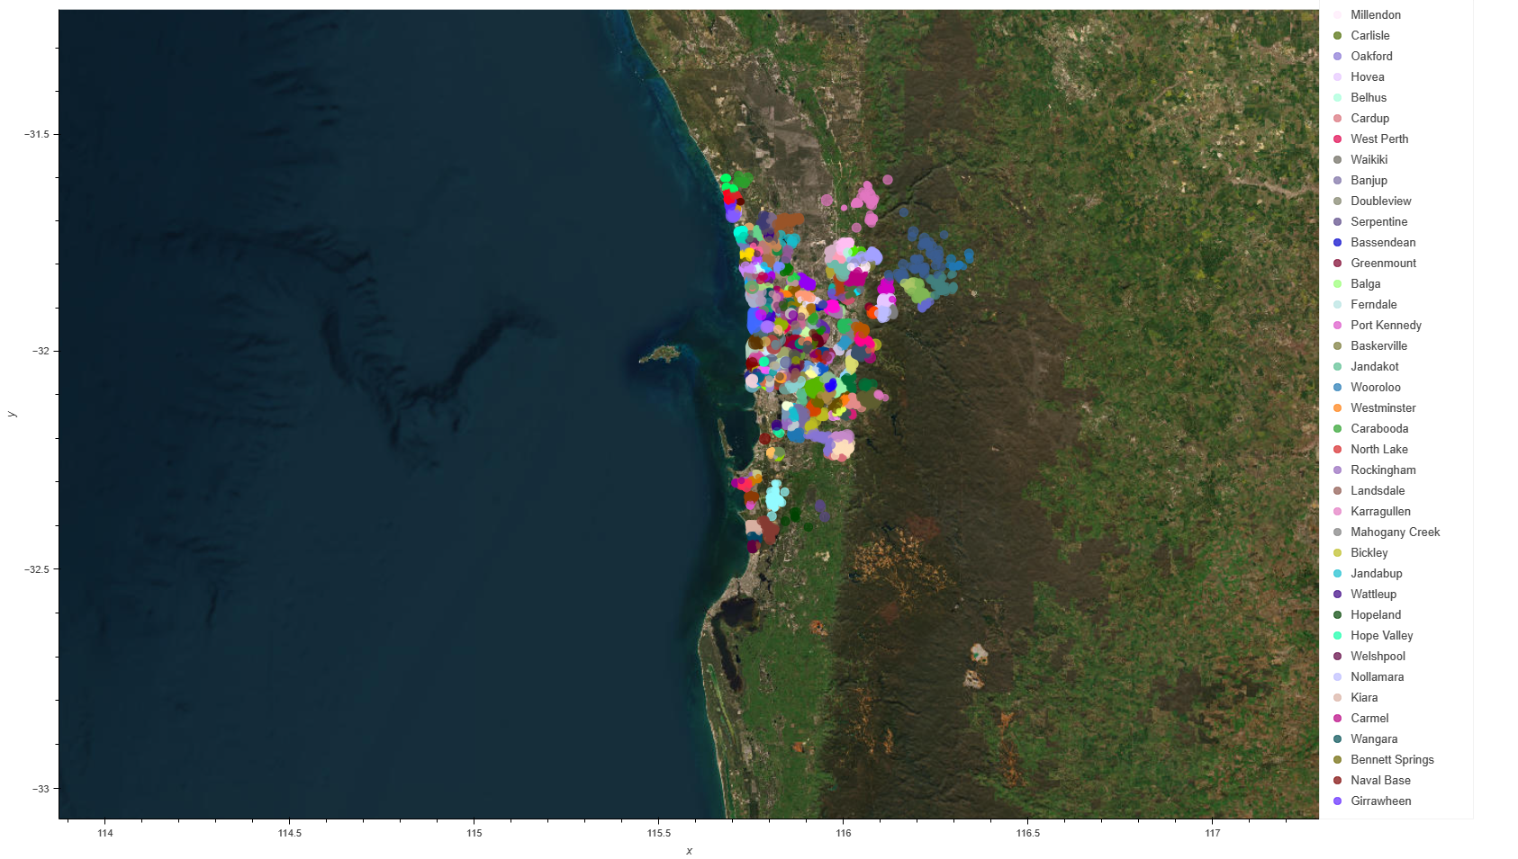
Total Sales within the Perth region from 2010 to 2020

Slide 5
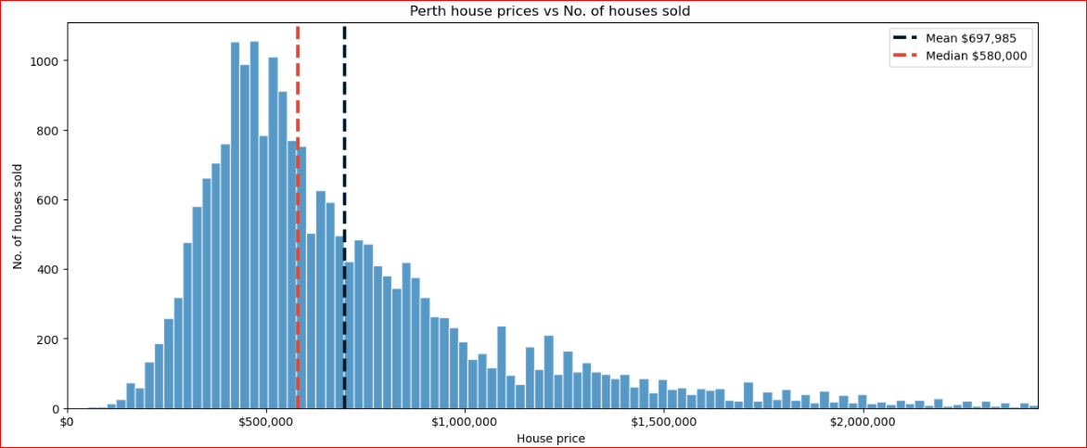

Slide 6
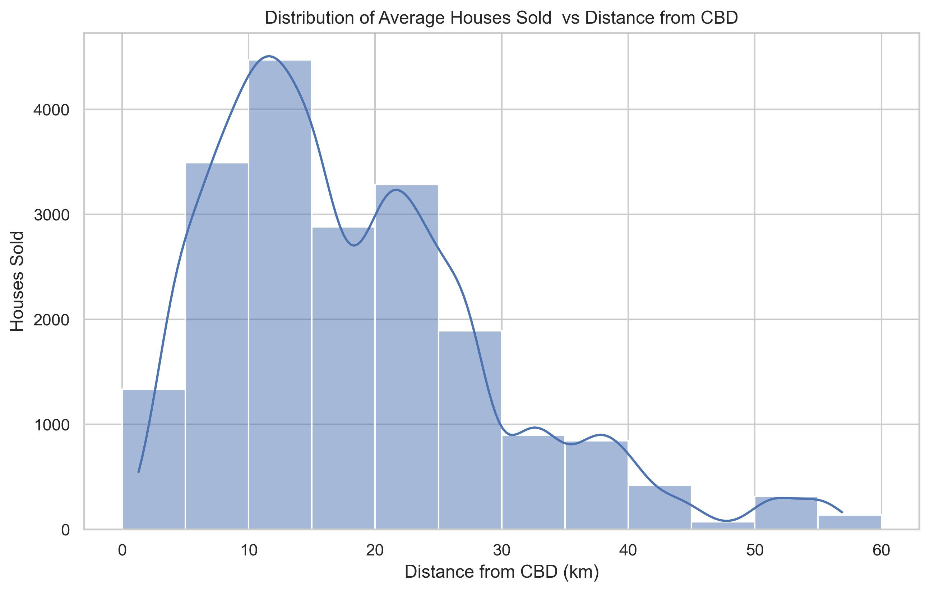

Slide 7
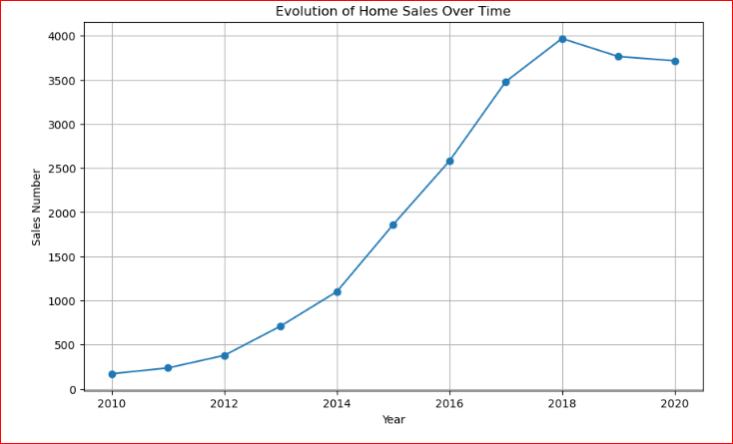
This graph represent the total houses sales per year, this is showing that the houses sold per year has steadily increased even during the time of the largest commodity price fall during 2014 and 2015

Slide 8
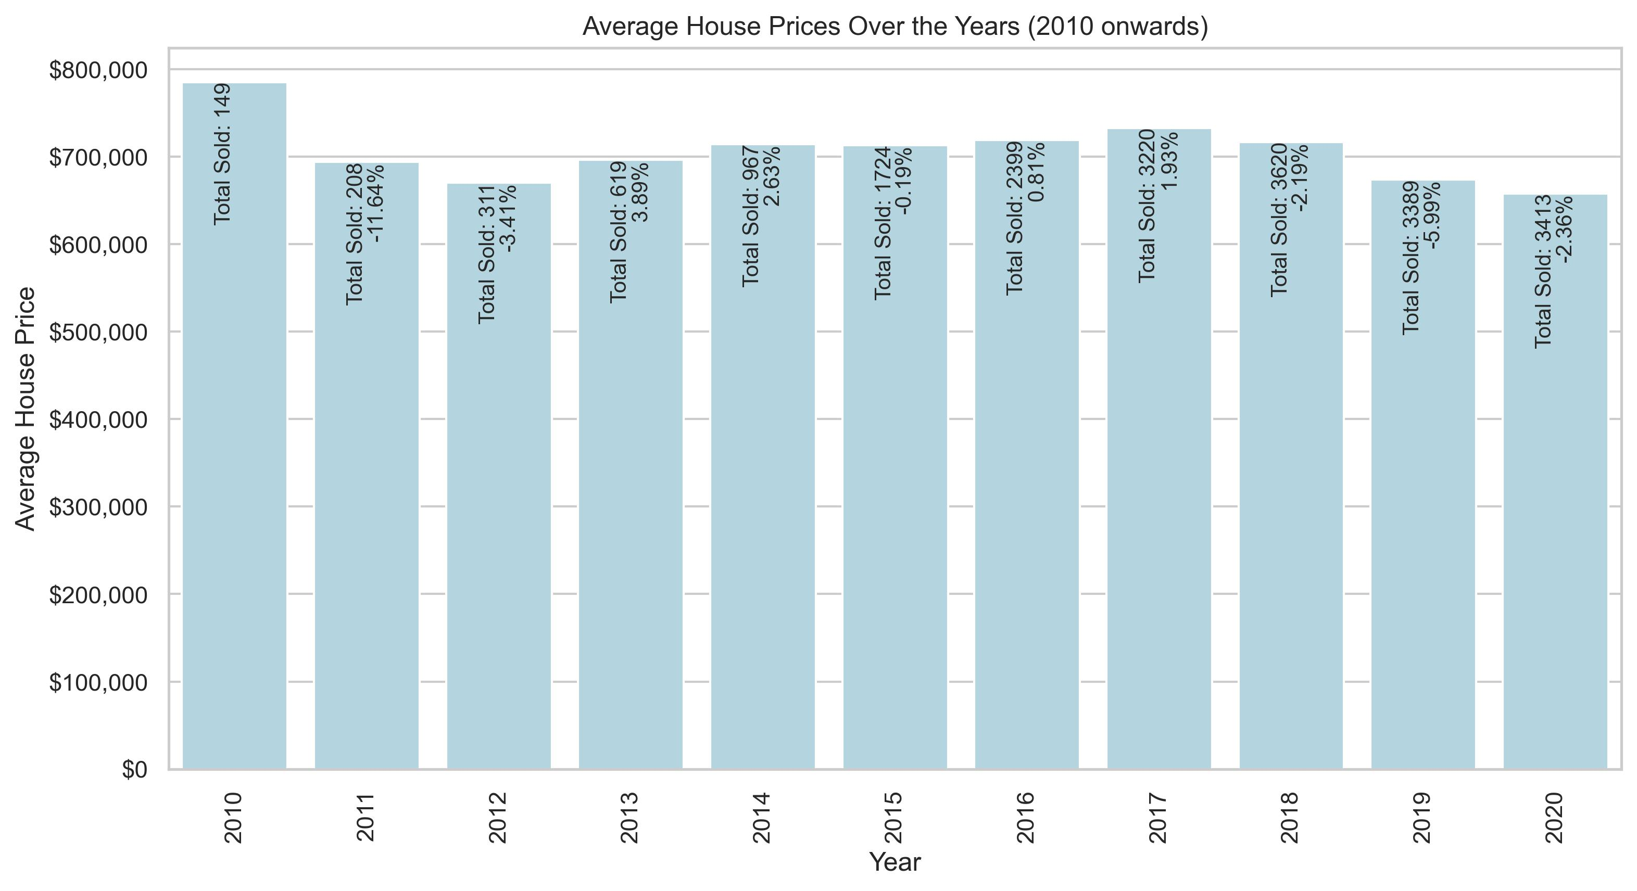
This graph represents the total sold properties during the years listed showing also the percentage variance in total sales compared to the previous year.

Slide 9
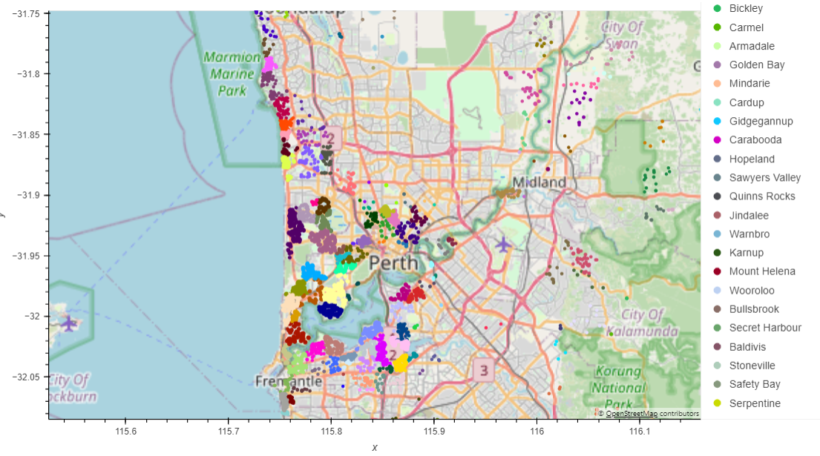
Highest 20% of total sales in all the data present shows that the majority of the houses sold in this bracket are very close to the CBD location which has better schools, infrastructure, shopping centres and transportation

Slide 10
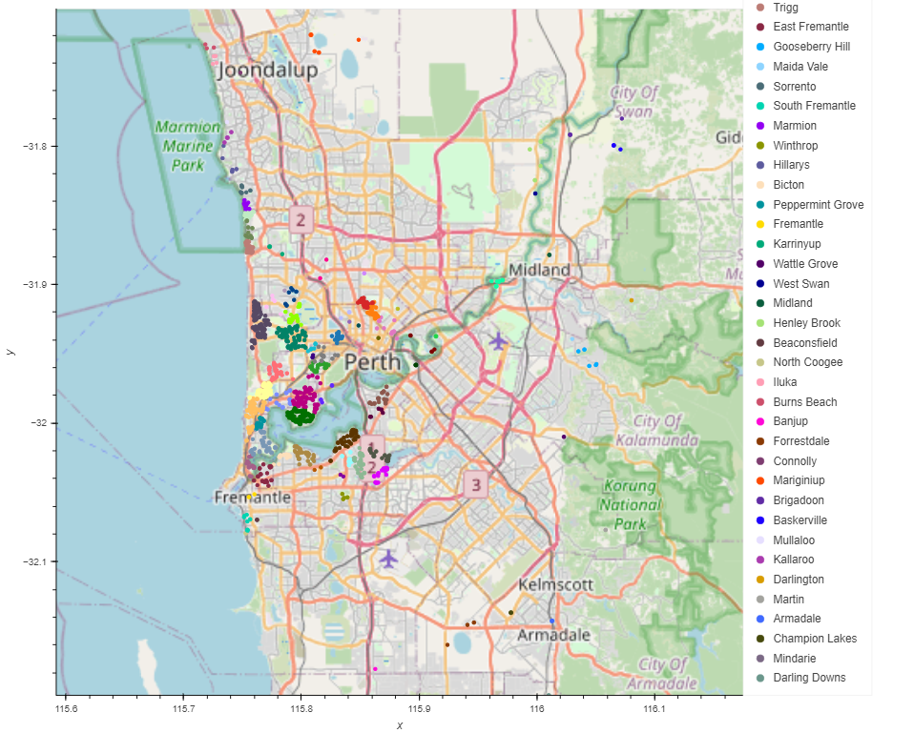
Top 5% overall sale price

Slide 11
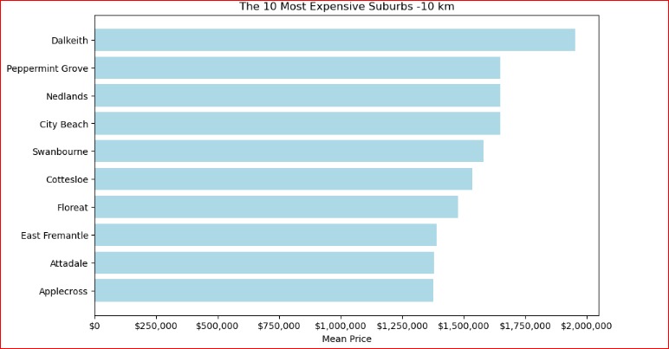
This graph represents the most expensive sales prices in the 10km region from the city centre, this is just based off total sales figures not taking into account bedrooms or bathrooms

Slide 12
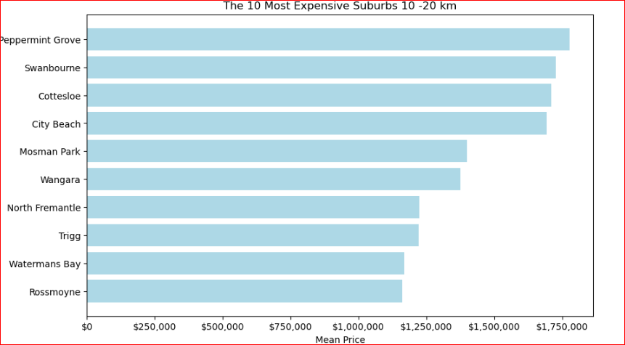

Slide 13
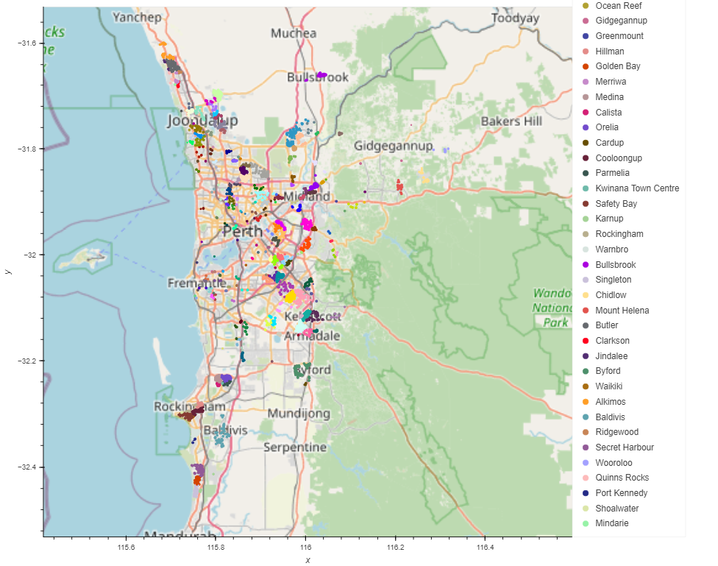
Bottom 20% overall

Slide 14
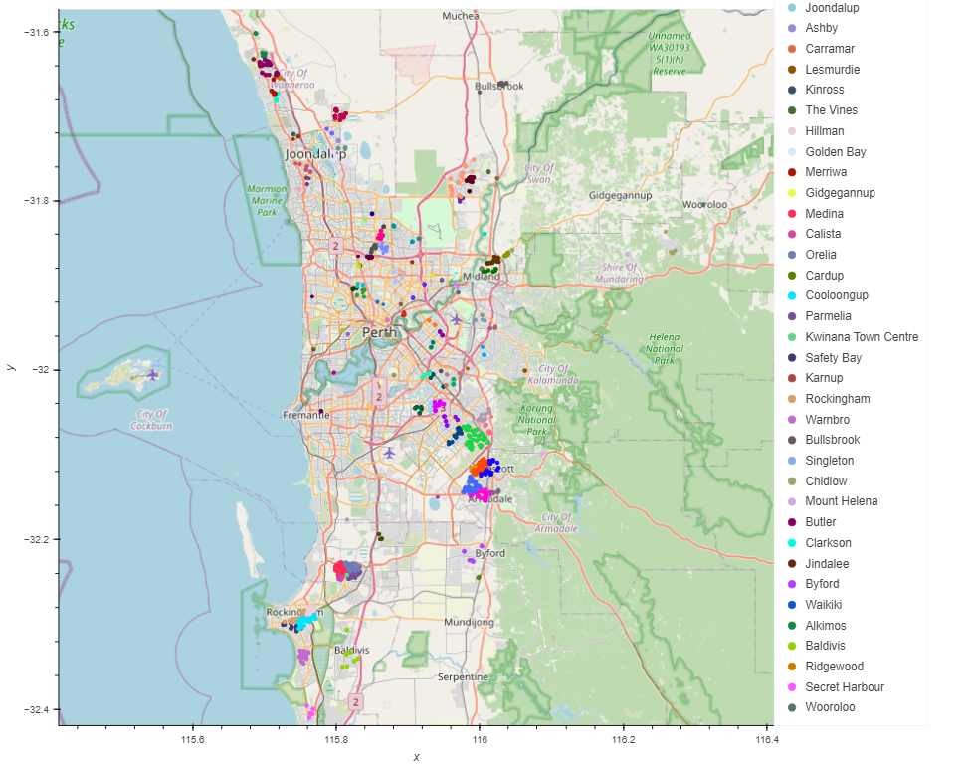
Bottom 5% overall

Slide 15
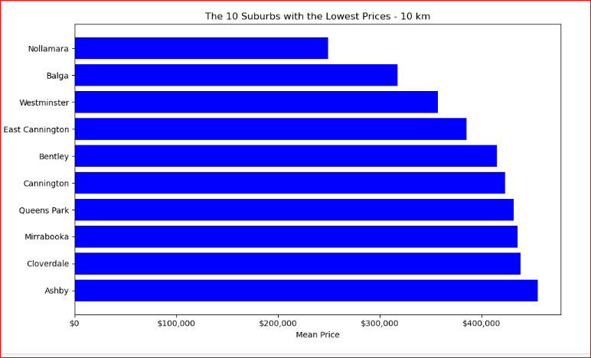
This graph represents the least expensive sales prices in the 10km region from the city centre, this is just based off total sales figures not taking into account bedrooms or bathrooms

Slide 16
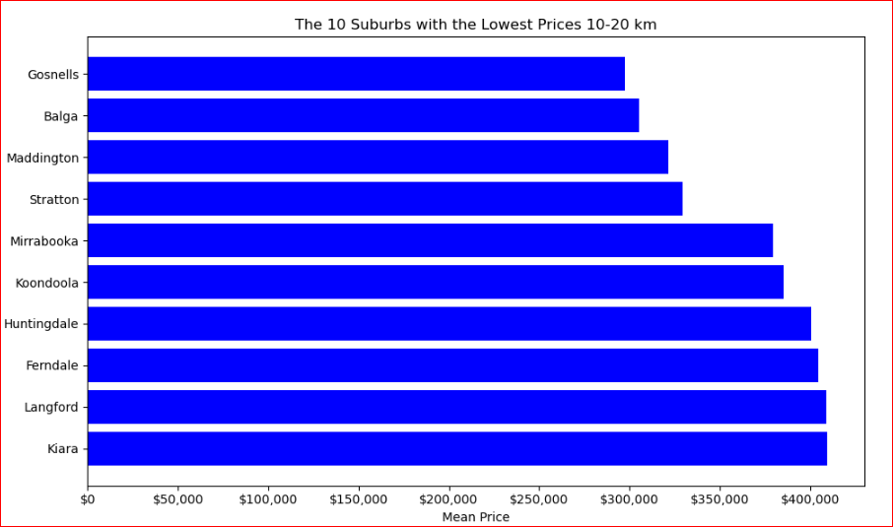

Slide 17
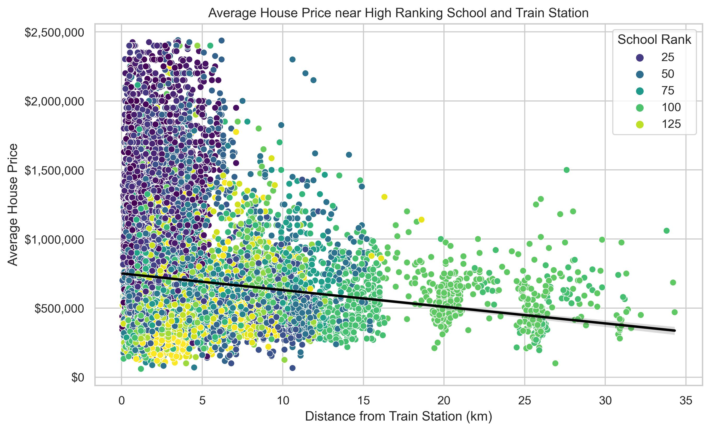
This plot is correlating the previous slides data showing that the school rankings are closely matched to the price of housing and the higher school ranking is also matched with the higher average house price sale and proximity to transportation and the CBD.

Slide 18
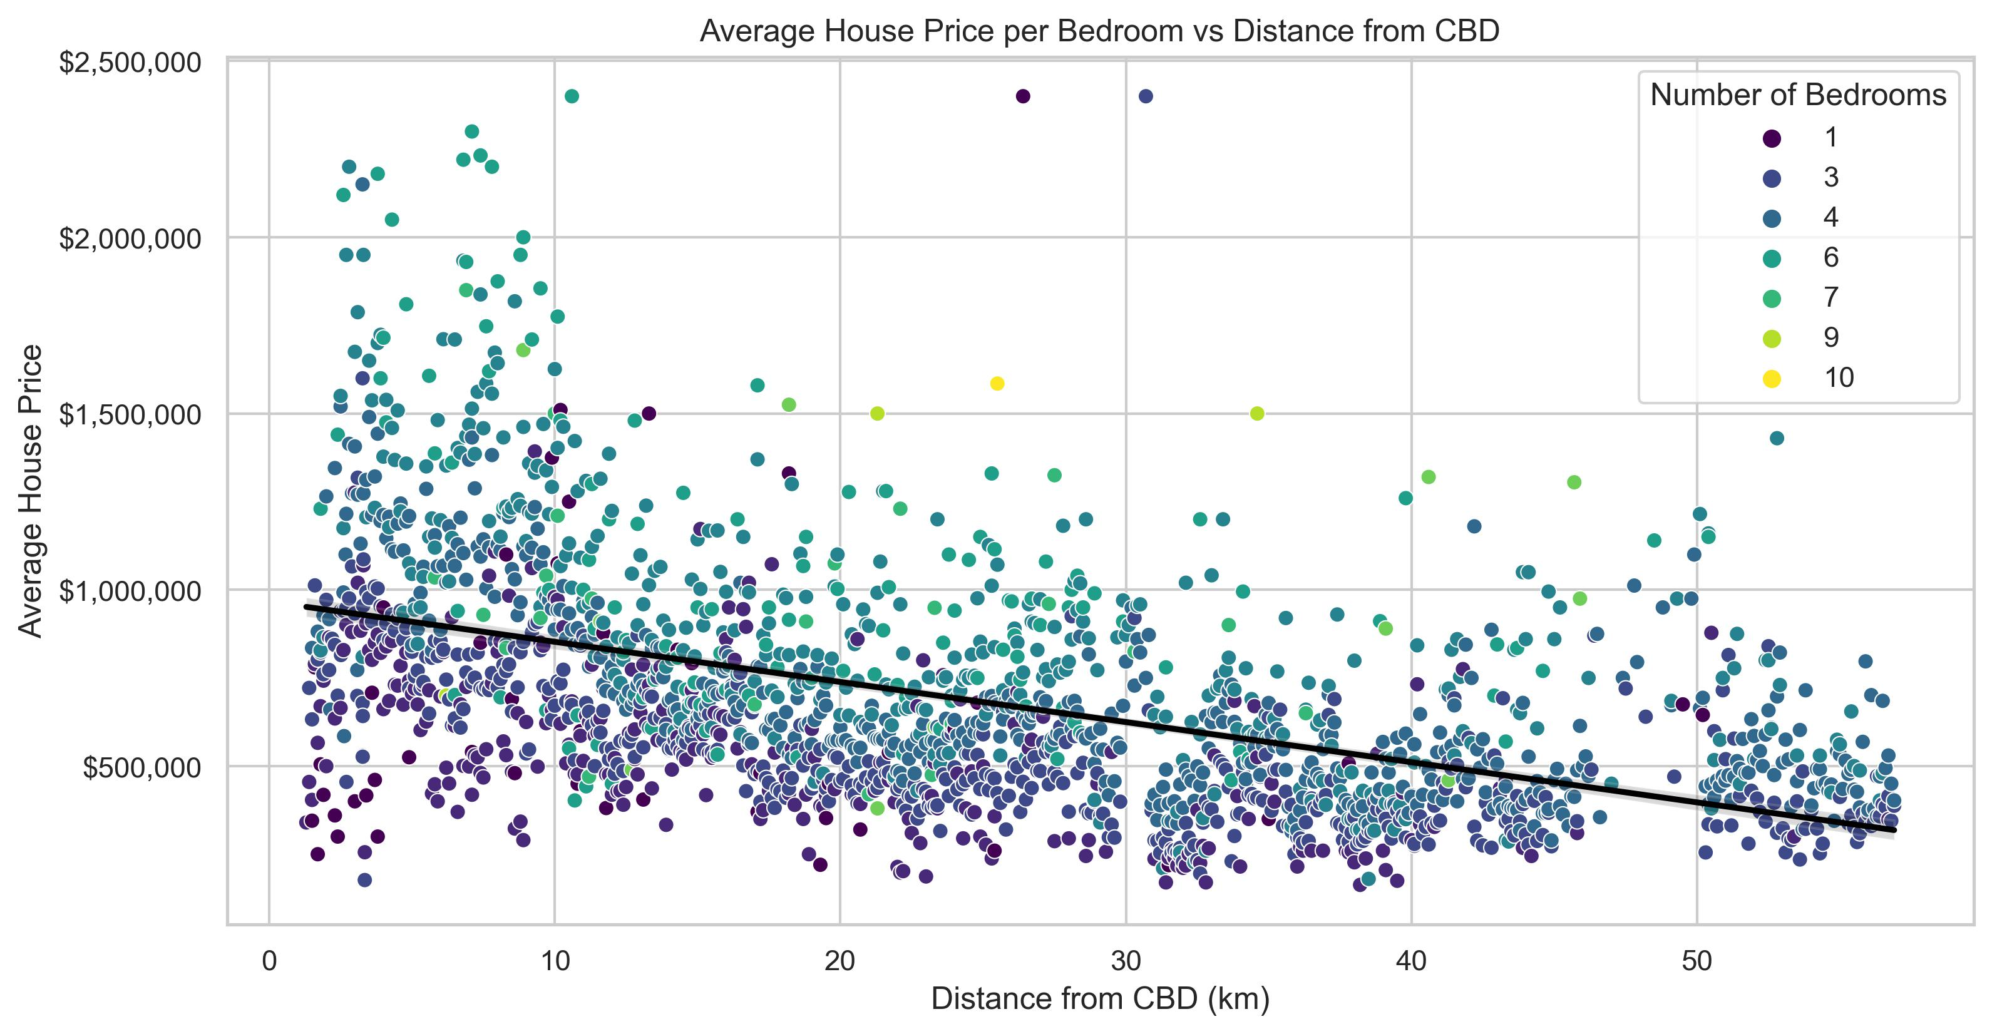
We have found that the average house sold nearer the city has lower bedrooms on average than houses being sold further out from the city.
The housing closer to the city are older constructed houses which typically had less rooms than the newer housing estates being created in the outer suburbs with building caveats on floor area and land sizes.

Slide 19
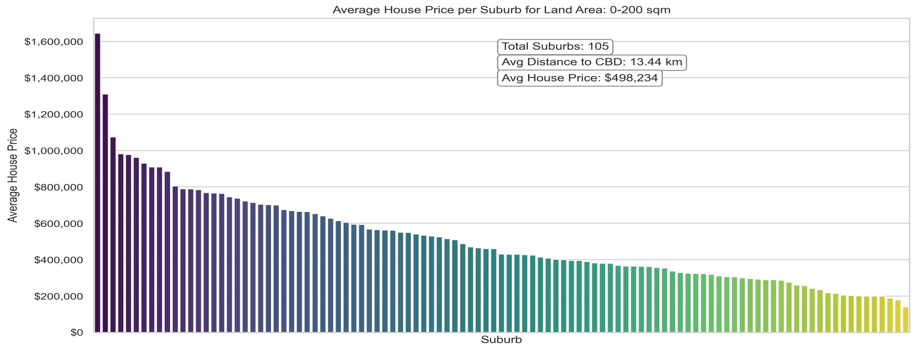
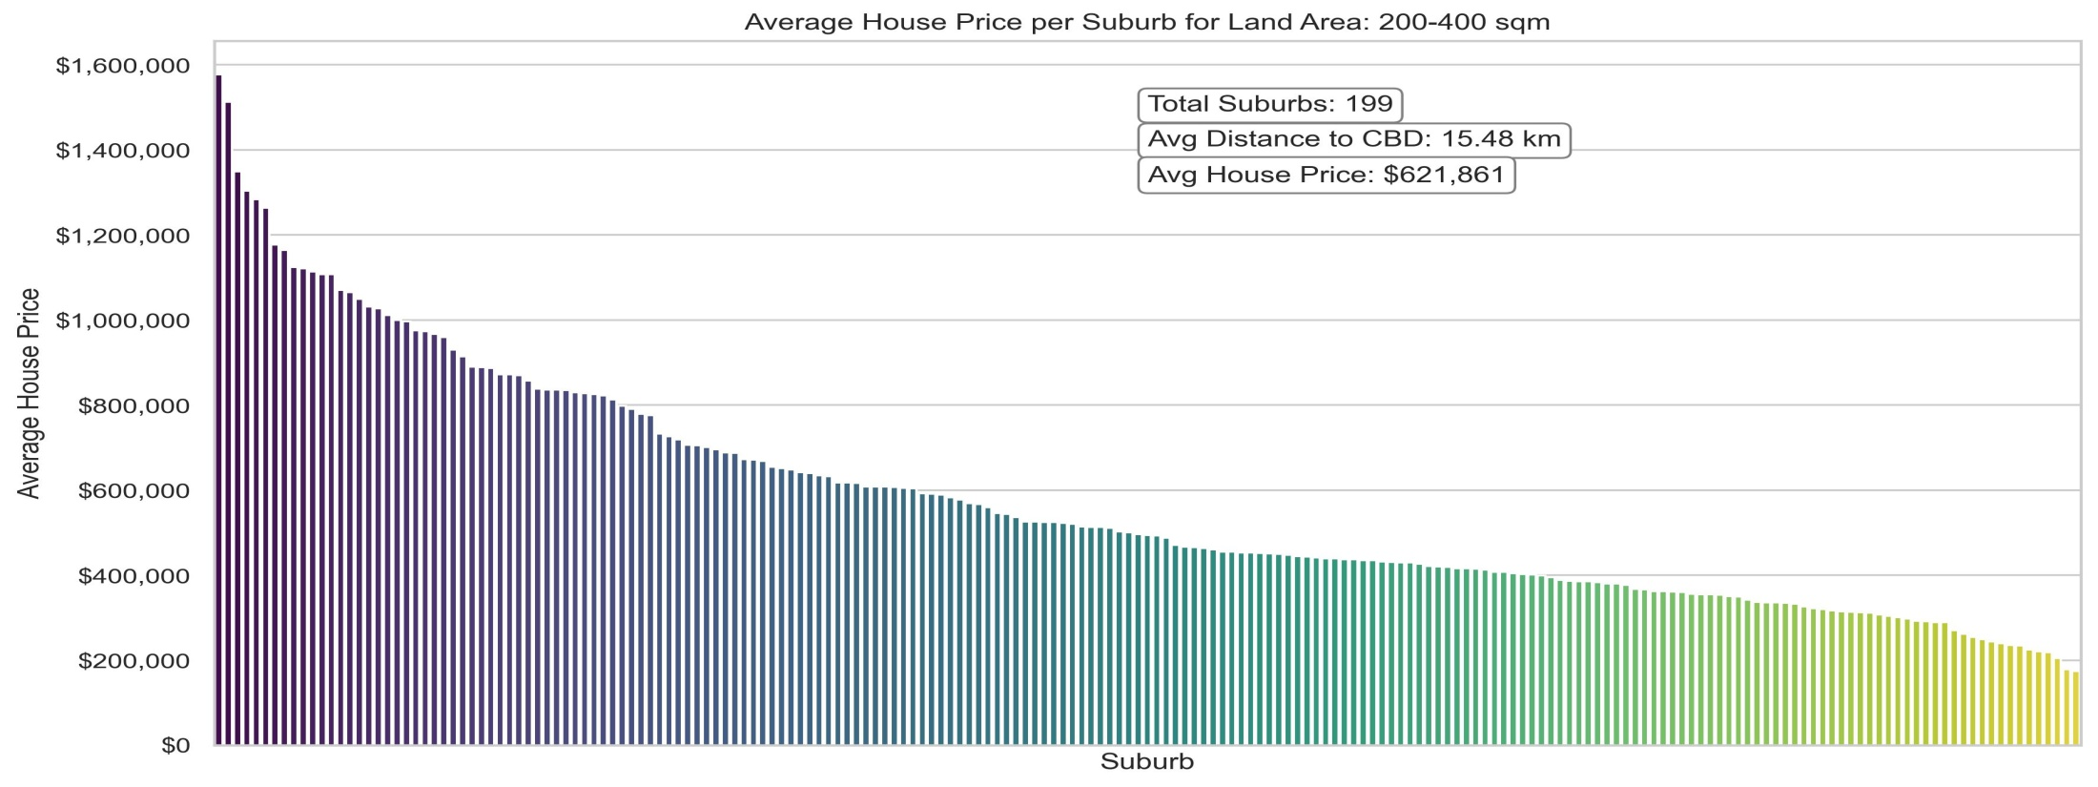

Slide 20
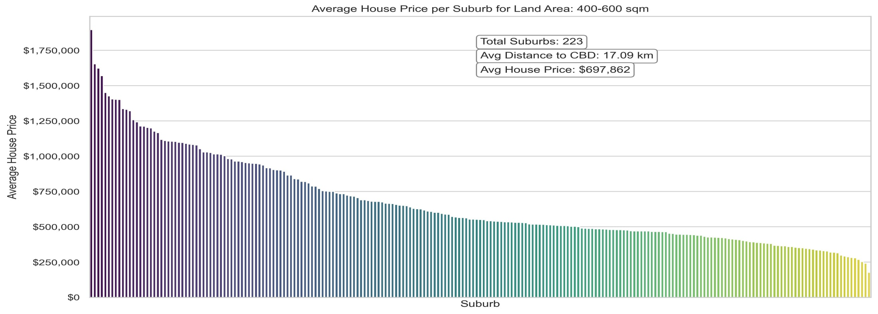
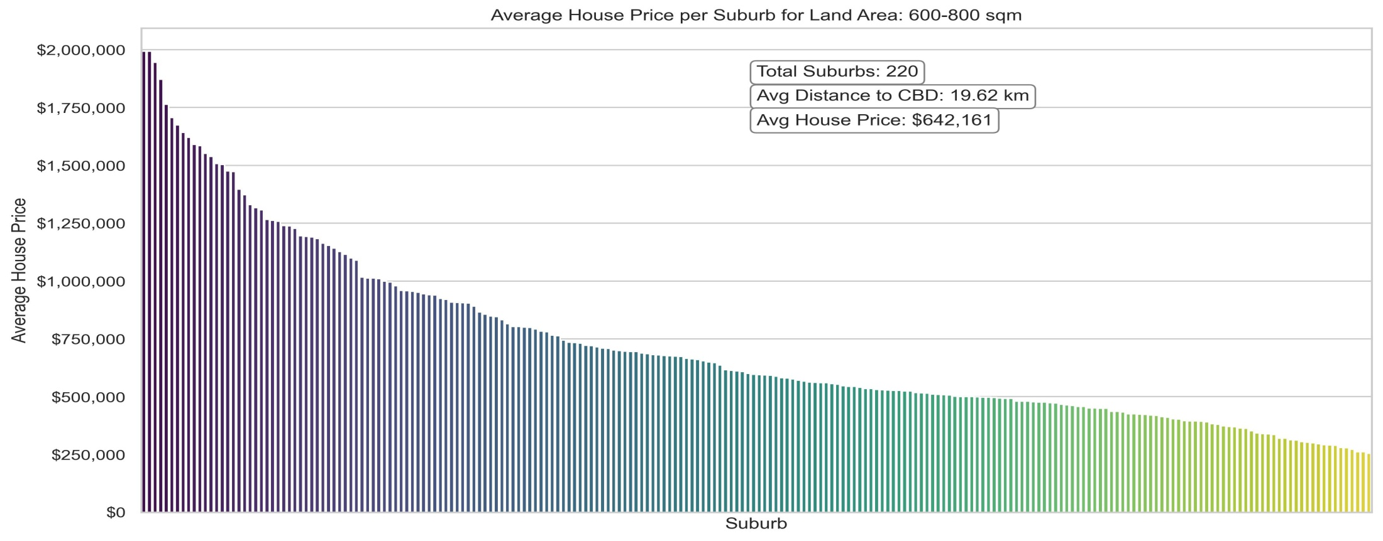

Slide 21
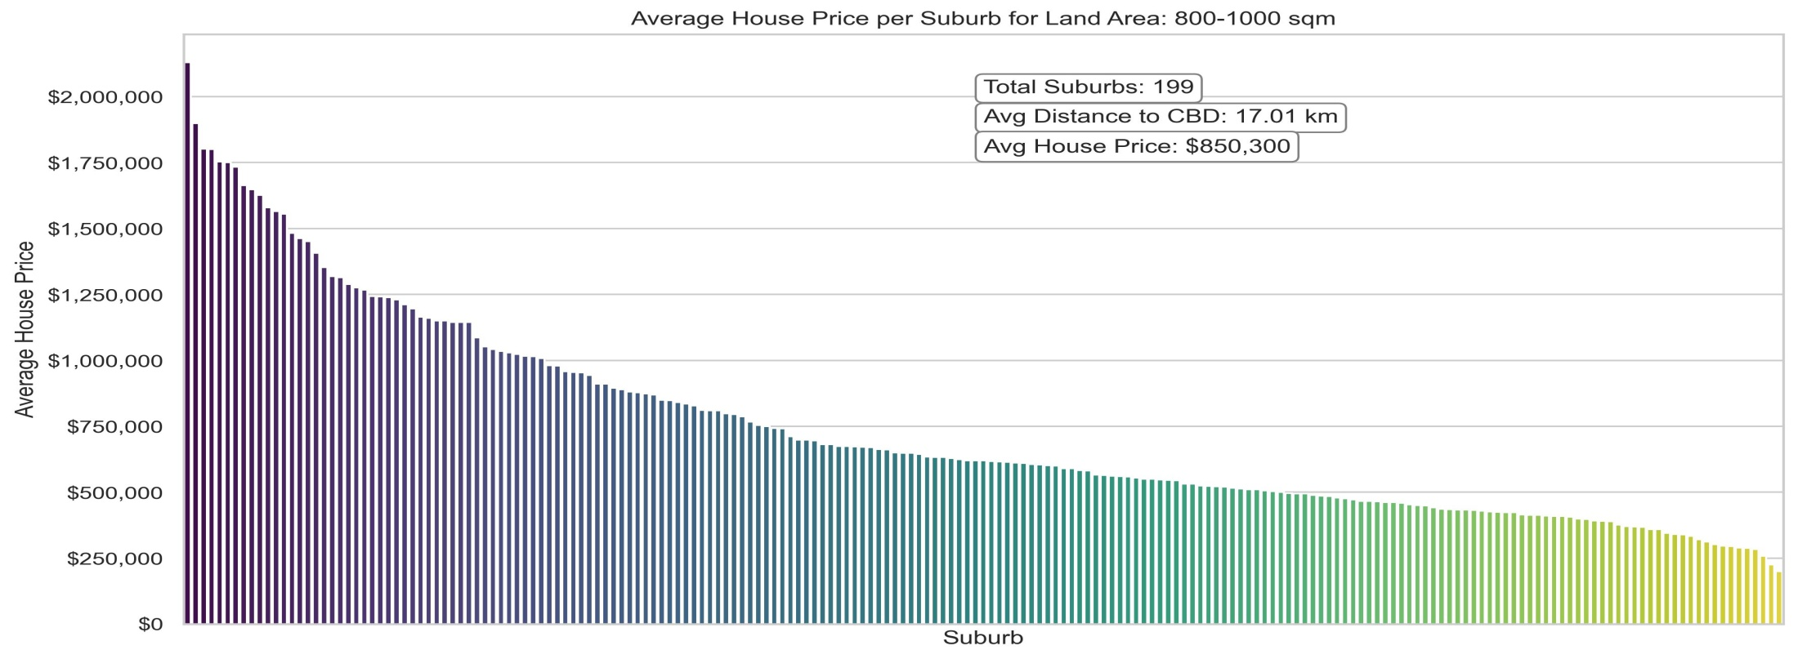
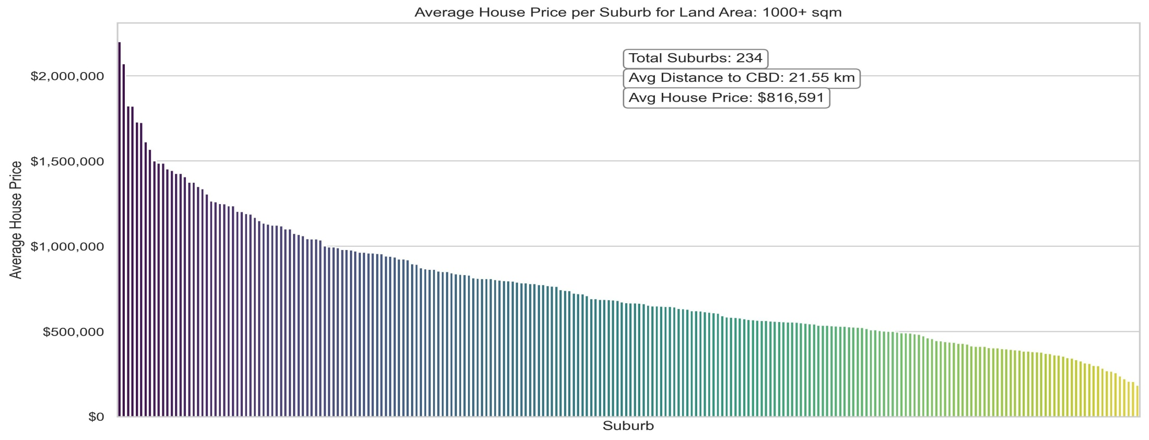

Slide 22
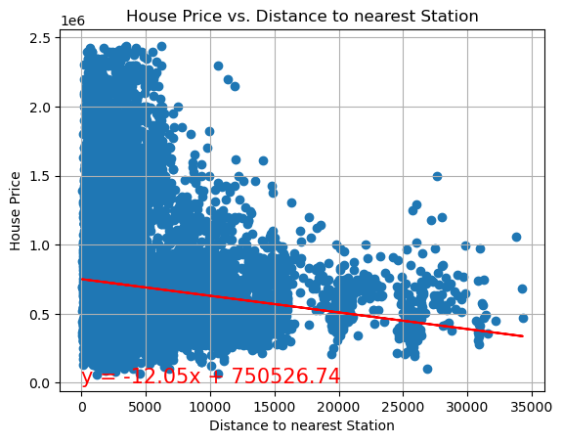
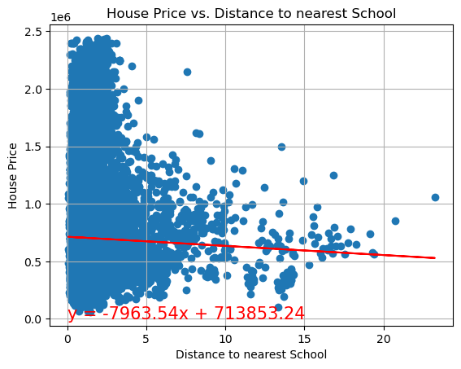
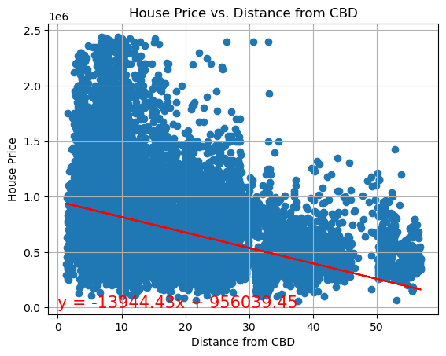
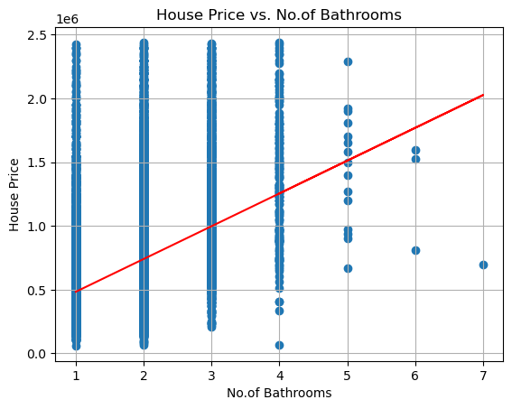

Slide 23
All of our Analysis has pointed to the below points:
Houses closer to transportation have a higher avg sale price.
Houses closer to schools have a higher avg sale price.
Houses closer to the CBD have a higher avg sale price.
Houses with more bedrooms have a higher sale price.

